Slide 1
K-means clustering
Vera Hollink
2025

Slide 2
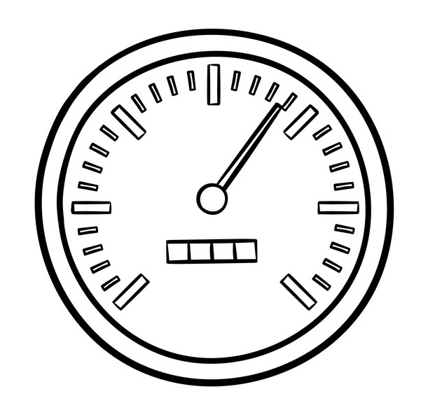
Summary last class

Slide 3
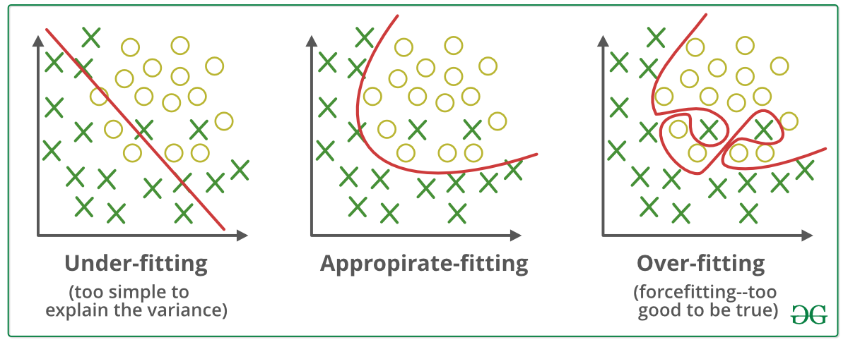
Overfitting & underfitting

Slide 4
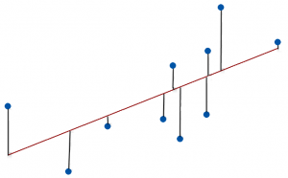
Regression evaluation measures
Coefficient of determination R²
Mean absolute error
Mean squared error

Slide 5
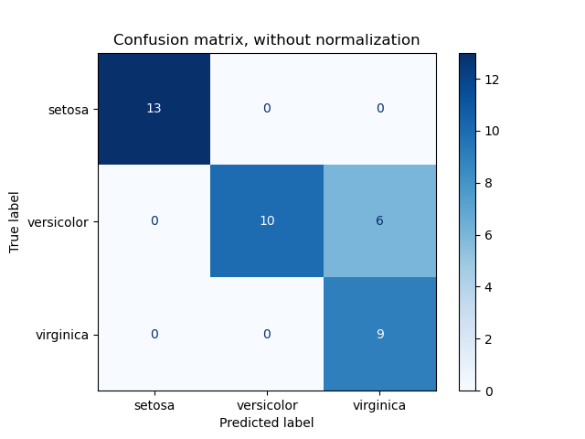
Classification evaluation measures
Confusion matrix
Accuracy
Error rate
Precision
Recall
F-score

Slide 6
Training & tuning & testing
Data
Training set, (validation set), test set
Percentage split
k-fold cross-validation
Hyperparameter optimization
Training and validation set
Grid search, random search
Statistical significance
k-fold cross-validation → paired t-test

Slide 7
K-means clustering

Slide 8
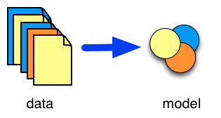
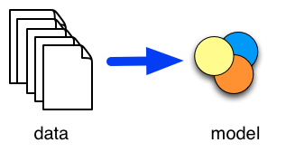
Types of tasks
Supervised learning
Unsupervised learning
Classification
Prediction
Time-series (forecasting)
Clustering
Associations

Slide 9
K-means clustering example: customers
age
Income

Slide 10
Example: customers
age
Income

Slide 11
Example: customers
age
Income

Slide 12
Example: customers
age
Income

Slide 13
Example: customers
age
Income

Slide 14
Example: customers
age
Income

Slide 15
Example: customers
age
Income

Slide 16
Example: customers
age
Income

Slide 17
Example: customers
age
Income

Slide 18
Example: customers
age
Income

Slide 19
Example: customers
age
Income

Slide 20
Example: customers
age
Income

Slide 21
Example: customers
age
Income

Slide 22
K-means clustering
Initialization
Assign k random instances as cluster centroids
Repeat until convergence
Compute distance of each instance to each centroid
Place each instance in closest cluster
Compute new centroids

Slide 23
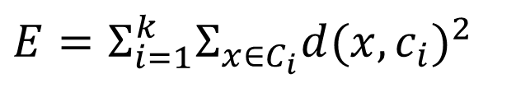
Concepts k-means
Partitioning method
k centroids
Minimize:
C_{i} is the i^{th} cluster
c_{i} is the mean (centroid) of the i^{th} cluster
$$E=Σ_{i=1}^{k}Σ_{x∈C_{i}}d(x,c_{i})^{2}$$

Slide 24
Try it: Cluster data with k-means
Height of some trees in cm:
560 569 571 572 580 620 620 622 630
k = 2
starting cluster centers: 560 en 580

Slide 25
Try it: Cluster data with k-means 560 569 571 572 580 620 620 622 630
Step 1:
cluster 1: 560, 569
cluster 2: 571, 572, 580, 620, 620 622, 630
center 1: mean(560,569) = 564.5
center 2: mean(571,572,580,620,620,622,630) = 602.1
Step 2:
cluster 1: 560, 569, 571, 572, 580
cluster 2: 620, 620 622, 630

Slide 26
Try it: Cluster data with k-means 560 569 571 572 580 620 620 622 630
center 1: mean(560, 569, 571, 572, 580) = 570.4
center 2: mean(620, 620 622, 630) = 623.0
Step 3:
cluster 1: 560, 569, 571, 572, 580
cluster 2: 620, 620 622, 630
Same as step 2 → Done!

Slide 27
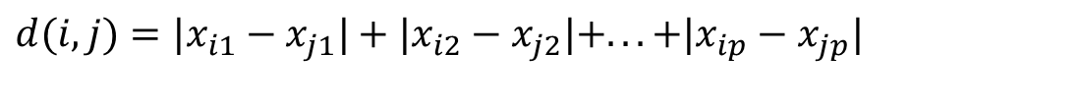
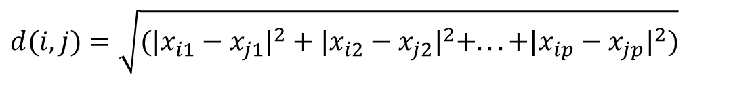
How to measure the distance in more than 1 dimension?
Euclidean distance
Manhattan distance
Chebyshev distance
$$d(i,j)=\sqrt{(|x_{i1}−x_{j1}|^{2}+|x_{i2}−x_{j2}|^{2}+...+|x_{ip}−x_{jp}|^{2})}$$
$$d(i,j)=|x_{i1}−x_{j1}|+|x_{i2}−x_{j2}|+...+|x_{ip}−x_{jp}|$$
$$d\left(i,j\right)=max⁡(\left|x_{i1}−x_{j1}\right|,\left|x_{i2}−x_{j2}\right|,…,\left|x_{ip}−x_{jp}\right|)$$

Slide 28

K-means with scikit-learn
# import libraries
from sklearn.cluster import kmeans
# load data
X = …
# build cluster model
kmeans_model = KMeans(n_clusters=3)
kmeans_model.fit(X)

Slide 29
Choosing the number of clusters
Elbow method
Cluster with various values for k
For each clustering compute within cluster distance
Plot k vs within cluster distance
Choose k where within cluster distance levels out
$$E=Σ_{i=1}^{k}Σ_{x∈C_{i}}d(x,c_{i})^{2}$$

Slide 30
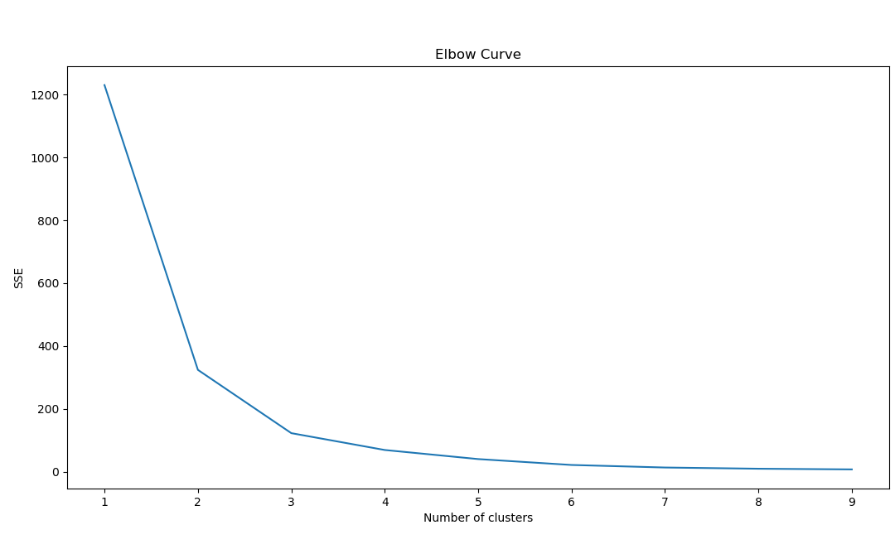
Choosing the number of clusters

Slide 31
Limitations of k-means
Different initializations may lead to different clusterings
Works only with numerical data
Choosing k manually

Slide 32
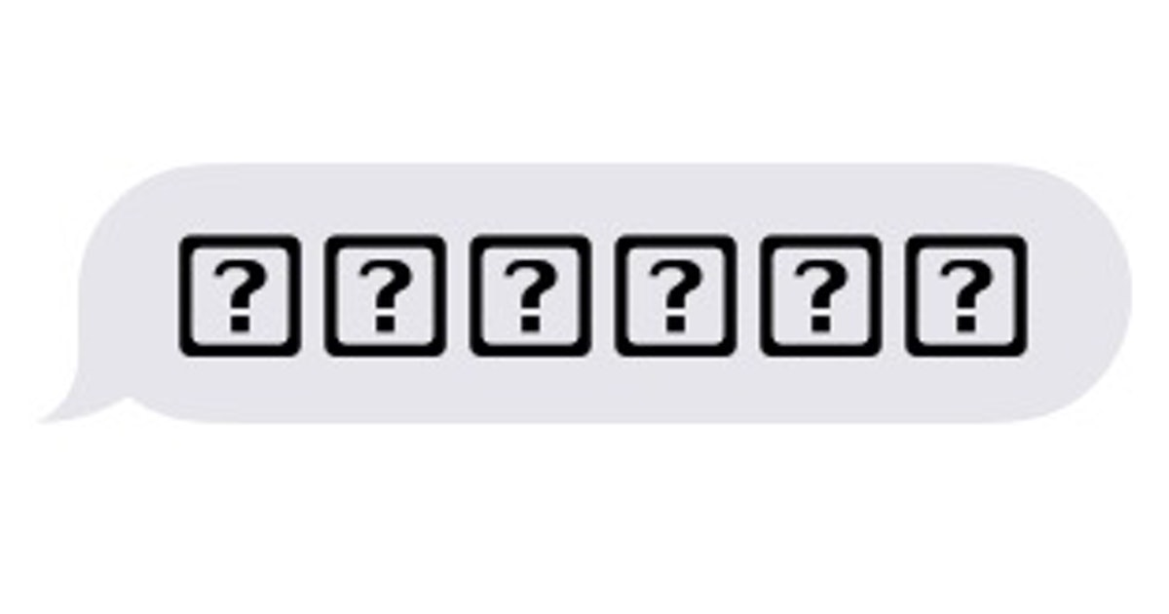
Questions?

Slide 33
And now…
Complete exercises
Work in pairs on assignment
Next class:
Sample exam

